Slide 2
Students’ activity
Discuss three importance of education

Slide 3
1. Difference between paragraph and paragraphing

Slide 4
THE PARAGRAPH
Osei Yaw Akoto
Department of English
KNUST, KUMASI

Slide 5
WHAT IS A PARAGRAPH?
A paragraph is a group of related sentences that develops one main idea.
Structural features of a paragraph
  Indentation
  Block

Slide 6
Questions for discussion
Is there a one-sentence paragraph?

Slide 7
Qualities of a Good Paragraph

Slide 8
Unity (1)
Every sentence in the paragraph must directly or indirectly support the main or central idea. A sentence is thus meaningless unless it is linked up with the total development of the central idea.

Slide 9
Coherence/Cohesion (2)
A paragraph is not a ‘forest of sentences’ rather sentences that are interconnected/related. A good paragraph is said to be cohesive when there is a ‘thread’ that ties all the sentences up to produce a ‘chain’.
Cohesive strategies:
Use of pronouns
Repetition of key words
Use of Synonyms of key words
Use of transitional words (e.g. firstly, moreover,

Slide 10
Completeness (3)
It means that the central idea captured in the paragraph must fully developed.
Some main ideas sometimes suffer:
  1. under-development
  2. overdevelopment: The writer may even end up repeating ideas.
  3. wrong development : A different idea, rather than the one stated, is developed. (refer to the slide from the College, see desktop)

Slide 11
Thus, a good paragraph is a UCC paragraph.

Slide 12
Paragraph Development

Slide 13
Functional Sentences in a Paragraph
Topic sentence
Major supporting sentence
Minor supporting sentence
Concluding sentence
Transitional sentence

Slide 14
Topic sentence (1)
It is the sentence that contains the main idea developed in a paragraph
Types
  Explicit: It is directly stated in the text, such that one can easily underline it. Common in expository and argumentative discourses/writings/essays.
  Implied : It is indirectly captured. One has to read the text and make deductions. Common in narrative and descriptive writings.

Slide 15
Placement of topic sentences (TS)
Three stages
  1. Initial stage
  2. Medial stage
  3. Final stage
  The positioning of a TS is informed by a number of factors:
  Style
  Formality
  The subject matter (topic)
  Purpose of writing

Slide 16
Major supporting sentence(MaSS) (2)
This is the sentence that directly develop the topic sentence. NB: There can be more than pone major supporting sentences in a paragraph.
I am pursuing higher education for a number of reasons. One, I want to obtain a good first degree in my area of study so that I can further to become the professor I have conceived to be.

Slide 17
Minor Supporting sentence (MiSS) (3)
It indirectly develops the topic sentence BUT directly develops the major supporting sentence. NB: There can be more than one MiSS to a MaSS.
………………………………………………………………………………………………………….
I am pursuing higher education for a number of reasons. One, I want to obtain a good first degree in my area of study so that I can further to become the professor I have conceived to be. I want to be an internationally acclaimed practicing academic nurse professor in pediatrics. In fact, I conceived this vision when I was made to act as a nurse in a sketch at class five.

Slide 18
Concluding sentence (3)
The concluding sentence mostly is the last sentence in a paragraph. It’s optional… but good to have one.
It..
re-states the topic sentence in a paragraph
summarizes the main views in the body pf the paragraph
may give writer’s final remark on a topic sentence

Slide 19
Transitional sentence (4)
It announces the ‘coming’ of the subsequent paragraph. It’s optional.
E.g. Having discussed broken home, in the next paragraph I will focus on peer pressure as another cause of teenage pregnancy.

Slide 20
Strategies for paragraph development
By this we mean how to develop the topic sentence in a paragraph

Slide 21
Definition –1
A number of factors account for why most first year students boast of enviable CWA after the first semester. CWA refers to...

Slide 22
Explanation
A number of factors account for why most first year students boast of enviable CWA after the first semester. These factors can classified as social, academic, financial, emotional or psychological.

Slide 23
Exemplification
For instance, for example, a case is…
A number of factors account for why most first year students boast of enviable CWA after the first semester. One of those factors is relative financial stability. Because their admission fees usually include hostel fees and other academic user fees, it takes a chunk of what may be considered as ‘post-first year financial worries’. As result, they have mental tranquility to undertake their academic responsibilities which include attending lectures, doing assignments, etc.

Slide 24
Description (
Appeal to the senses (at least one) of the readers.
One of the factors of teenage pregnancy in postmodern Ghana is broken home. A ‘home’ as we all know is a place of peace, belongingness, security, we-feeling, and any good thing that contribute to a positive self image of an individual. But when, it is said to be ‘broken’, the ‘can’t be held and therefore mere anarchy is loose upon the hitherto abode of joy. Father, who is the head (the roofing), is therefore disconnected from the mother and therefore the children are in most cases left to fend for themselves. Thus,…

Slide 25
Compare and contrast

Slide 26
Forms of Paragraphs
Introductory
Body
Concluding
It is usually perceived that an essay is all about the BODY. But scholars in composition studies/writing literacy/rhetoric have established that the MOST important parts of an essay are the INTRODUCTION and the CONCLUSION.

Slide 27
Why are the introduction and the conclusion considered the most important parts of an essay?

Slide 28
Introductory Paragraph (1)
The introductory paragraph should also include the thesis statement, a kind of mini-outline for the paper: it tells the reader what the essay is about. The last sentence of this paragraph must also contain a transitional "hook" which moves the reader to the first paragraph of the body of the paper
Functions of Introduction paragraph
  1. Capture readers attention
  2. Announce thesis statement
  3. Sometimes the plan of development/map of the essay

Slide 29
Formative Exercise
Write an essay on how lecturers can help students to achieve their aims.

Slide 30
Observation from students essays (1)
Paragraph analysis
Introductory sentence (s)
Topic sentence
MaSS
MiSS
Concluding sentence (s)

Slide 31
Observation from students essays (2)
Paragraph length: When is enough enough?

Slide 32
Observation from students essays (3)
Understanding of rubrics: ‘One paragraph’ not multiple paragraphs

Slide 33
Observation from students essays (2)
A major sentence without a minor one???????

Slide 34
Observation from students essays (4)
Catalogue of topic sentences

Slide 35
Sentence 1: 1st Introductory sentence
Sentence 2: 2nd Introductory sentence
Sentence 3: Topic sentence
Etc.

Slide 36
Attention-getters for introductory paragraph
Definition
History
Short story
Statistical facts
Proverbs/quotes
General background information

Slide 37
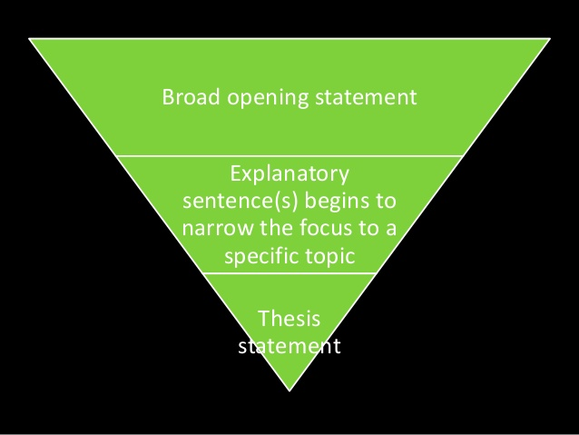
Structure of Introductory Paragraph

Slide 38
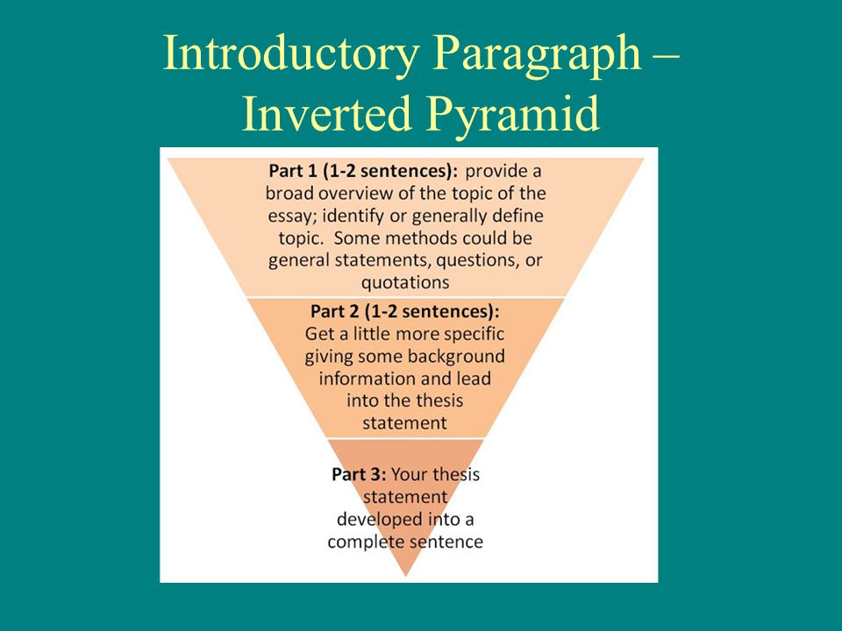

Slide 39
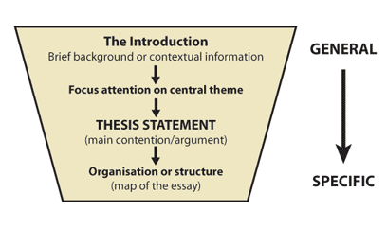

Slide 40
Body Paragraph (BP) –2
The one and only aim of BP to develop the thesis statement (thesis development)
The body paragraphs in your essay support the main idea in your thesis statement by breaking it down into smaller ideas or subtopics. Ideas in your paragraphs should relate back to the thesis statement.

Slide 41
The Concluding Paragraph (CP) –3
What the CP must not do:
1. development of a new idea not introduced in the body
2. re-writing of the introduction and body of the essay
What does it do?
re-states the thesis of the essay
Summarizes the body of the essay (a recap of the ‘top stories’)
Provides writer’s final remark: suggestion, recommendation, solutions, …
NB: The CP is a miniature essay (it has its introduction, boy and conclusion)

Slide 42
Signaling the end of an essay…
All in all,
in conclusion,
To end
Indeed, the paper has focused on the benefits on being a student in KNUST.
…

Slide 43
Paragraph Analysis

Slide 44
Read the following paragraphs carefully and analyse them into topic sentence, major supporting, minor supporting and concluding sentences. Use the sentence numbers in your analysis; do not write the entire sentence.

Slide 45
¹THE PERIOD BETWEEN 1972 AND 1982 WAS THE DARKEST IN GHANA’S POST-INDEPENDENCE HISTORY. ²First, it was characterized by political instability. ³There were as many as five change of government within this period –N. R. C. (1972), S. M. C. I (1975), S. M. C. II (1978), A. F. R. C. (1979), P. N. P. (1979), P. N. D. C. (1981). ⁴In addition, political rulership changed frequently between different forms of military dictatorship and totalitarianism and liberal democracy. ⁵The economy of the country suffered a heavy setback during this period. ⁶Inflation was higher than it had ever been. ⁷Per capita income was lowest, and there was a serious scarcity of everyday essential commodities. ⁸Further, economic malpractice reached an alarming height. ⁹The depression of the period was manifested at the social level also. ¹⁰Hard-work gave way to theft and laziness; and prostitution aggravated. ¹¹Honesty gave way to deceit. ¹²Ghanaians were taught disobedience, and hate the owners of property and to punish them for acquiring property. (Source: Sekyi-Baidoo, 2003)

Slide 46
¹Two main categories of people exist in this world –troublemakers and trouble-shooters. ²The former are people who mastermind all the chaos and atrocities in this world.³ Talk of the two world wars and you will have them around their remote and immediate causes.⁴ All the things in this world which are anti-human are the works of their hands, heads and hearts. ⁵Examples of these ungodly activities are human tracking, child abuse, same-sex intercourse, cyber crimes, armed robbery and the likes. ⁶It is surprising that even though these people are God’s creations, they rather do not have the loving spirit of God in them. ⁷But thank God for the existence of the other category of people who aims at transforming what the troublemakers have deformed. ⁸For instance, when the troublemakers created virus, they manufactured anti-virus. ⁹They help create home for refugees who, due to the nefarious activities of the troublemakers, are homeless ¹⁰Without trouble-shooters, there will be no ‘heavens’ for those who have been made victims in the ‘hells’ created by the troublemakers. ¹¹Really, they make bitter life better to people. ¹²Indeed, it is always good to have an eraser wherever there are pencils.

Slide 47
¹Some scholars maintain that there are two broad causes of climate change. ²Truly, the earth’s climate is influenced and changed through natural causes. ³When volcano erupts, it throws out large volumes of sulphur dioxide (SO²), water vapour, dust, and ash into the atmosphere. ⁴Although, the volcanic activity may last for a few days, the large volumes of gases and ash can influence climatic patterns for years. ⁵Millions of tonnes of sulphur dioxide gas can reach the upper levels of the atmosphere (called the atmosphere) from a major eruption. ⁶The gases and dust particles partially block the incoming rays of the sun, leading to cooling. ⁷ But the world climate is not only changing through a natural dynamic cycle but also what the world is worried about is that the change that is occurring today has been speeded up by human activities. ⁸So, there are three types of human activities which contribute to climate change. ⁹Industrialization is listed by scientists as the most significant human cause of climate change.¹⁰Indeed, climate change can be said to be a negative consequence of both human-related and natural factors.

Slide 48
¹The discovery of oil in Ghana in commercial quantities is a blessing to all. ²First, it has provided employment opportunities for many people. ³Many skilled professionals such as engineers, accountants and managers, as well many unskilled workers such as labourers and cleaners are gainfully employed in the various oil drilling companies. ⁴Apart from these categories of people who are directly employed in the oil companies, private businessmen, traders and wayside hawkers alike are also indirectly involved in the oil business. ⁵Second, the drilling of oil in Ghana is a major foreign exchange earner for the country. ⁶Like gold, cocoa and bauxite, the oil that is sent out of the country brings in substantial revenue which is used in infrastructural development such as building of schools, hospitals, and roads. ⁷In addition, the discovery of oil in Ghana has made us less-dependent on other oil-producing countries for our petroleum product needs, thereby saving us costs. ⁸Finally, every worker employed directly or indirectly in the oil industry is required by law to pay tax. ⁹Such taxes also help in the growth of the economy of the country. ¹⁰It is therefore not surprising that all political regimes Ghana has had have made efforts to discover oil in commercial quantities.

Slide 49
¹The internet is one of the most useful inventions of our time but, like all useful things, its abuse can be very worrying. ²The World Wide Web, as it is sometimes called, serves the triple function of informing, educating and entertaining.³ it is easy enough to pick the latest news and other happenings around the world in real time, as well as follow events as they occur. ⁴The net also makes it possible for researchers, teachers and students to access the needed information, most of which is free. ⁵Teachers, for instance, can use information from the net to put together their teaching notes while students can also complement what they learn in class with additional information from the net. ⁶Social media like Facebook, Instagram and Twitter also help to connect people around the world to share ideas and follow their interests. ⁷The net also provides opportunities for entertainment where people can watch movies on the net and follow sporting events including soccer, which most of us are fond of. ⁸However, many people, especially young persons, can easily be influenced negatively by some of the harmful information on the net. ⁹Sadly, there are many sites that promote pornography, violence and religious radicalism. ¹⁰The internet may be a blessing, but we must also be mindful of the potential harm it can cause us.

Slide 50
TYPES OF PARAGRAPH
Narrative
Descriptive
Expository
Argumentative

Slide 51
Structure of an Essay

Slide 52
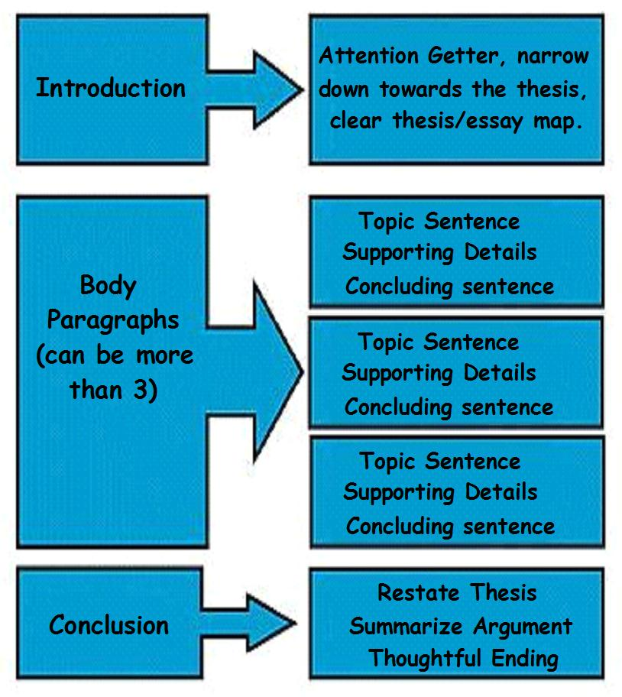
Structure of an Essay

Slide 53
Still in Writing stage….
Freewriting on the developed outline (No focus on grammar and language)
Produce a draft

Slide 54
Post-writing Stage: Editing and Proofreading

Slide 55
What is editing?
Another name for this is global revision.

Slide 56
TYPES OF EDITING
Self-editing
Peer-editing
Group-editing

Slide 57
The State Protocol Department has denied claims by the founder of the Ghana Freedom Party (GFP), Madam Akua Donkor that they have been given express instructions not to invite her and Dr Hassan Ayariga to state functions. Madam Akua Donkor disclosed that she does not receive invites as she used to and in an attempt to find out from the State Protocol Department (SPD), she was told by one Mensah that her name is not among persons to be invited for such events as directed by the presidency. Akua Donkor believes the current President, Nana Addo Dankwa Akufo-Addo despises not only her but Dr Hassan Ayariga of the All Peoples Congress (NDC) for which reason they have both been relegated to the background. “Nana Addo does not like me and Hassan Ayariga. I am sure that is why he has directed them not invite me for state functions but I don’t care”, he revealed on Kumasi-based Abusua Fm. But Deputy Chief Protocol Officer at the State protocol department Nana Mensah refuted claims that he refused to give her invite adding that the President had no hand in the protocol list. According to him, the GFP leader knows the processes involved in extending such invitations denying the claim that they showed her a list which did not contain her name. ‘Prior to the Independence Day for example, I told her to hang around for a while because the one in charge of invitation cards had stepped out, the time I realised, she had left unannounced. She knows how we have been assisting her even when she wants to travel outside the country. I am just wondering why she has decided to go to the media with such an issue. If it is also about the State of the Nation Address, we at SPD do not handle that, Parliament does,’ he explained.

Slide 58
FOCUS OF EDITING: CONTENT (1)
Relevance
Adequacy
Consistency
Accuracy

Slide 59
FOCUS OF EDITING: STRUCTURE (2)
Generic requirements (letter, memo, abstract, etc)
Well-organized (introduction, developing paragraphs, and concluding paragraphs)
Logical sequencing
Transitional markers

Slide 60
FOCUS OF EDITING: CLARITY (3)
At word, phrase, clausal, and sentence levels
Ambiguity and vagueness
Dangling or misrelated constructions
Sentence fragments and run-on sentences
Awkward sentences
Inappropriate lexical choices

Slide 61
FOCUS OF EDITING: STYLE (4)
Level of formality
Appropriate tone
Sentence beginning, length, variety, and complexity
Paragraph length
Gender-sensitive language
Nominalized
Verbalized
N.B. Many factors affect style: aim, audience, and topic

Slide 62
FOCUS OF EDITING: FORMATTING (5)
Lecturer’s/department’s/institution’s guidelines
Spacing, font size, font type,
Margins
Bold, italics, underlining
Pagination
Table, figure, and chart
References/Bibliography
Word limit

Slide 63
FOCUS OF EDITING: CONCISENESS (6)
Replace several vague words with specific words
Adopt effective sentence combining practices
Replace a phrase with a word
Dispense with words that have very little utility value: ‘actually’, ‘basically’, ‘practically’
Avoid redundancies: ‘basic fundamentals’, ‘free gift’, ‘large in size’, ‘round in shape’

Slide 64
PROOFREADING
This may be termed surface revision. It largely focuses on the mechanics of the language use.

Slide 65
FOCUS OF PROOREADING
Concord
Spelling
Punctuation
Tense
Repetition of words (e.g. Africans must be be patriotic)

Slide 66
SOME GUIDELINES FOR EDITING/PROOFREADING
Maintain some distance from the text in terms of time
Decide what medium allows you to edit most carefully
Find a quiet place
Edit and proofread in several short blocks of time, rather than all at once

